Slide 1
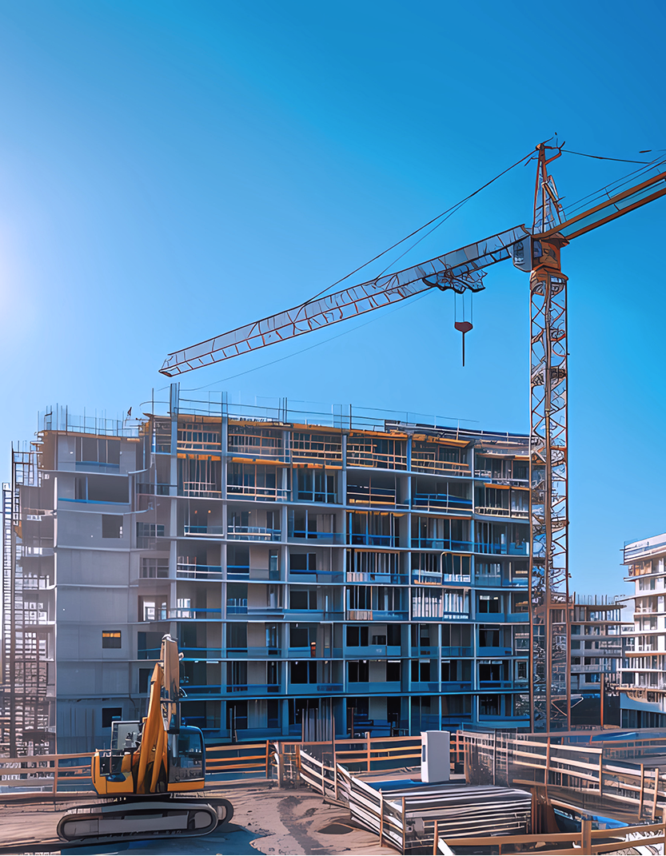
Using our innovation expertise for asset intelligent monitoring (‘AIM’)
ASSET INTELLIGENCE & SECURITY
THE CHALLENGE
Industries are struggling with monitoring their assets leading to asset loss, safety issues, inefficiency, and high costs.
THE SOLUTION
Using state of the art cellular and LoRaWAN technology, we are creating bespoke solutions for customers, from live construction sites to high value asset storage.
Once we’ve completed a business needs assessments, our IoT engineers work on creating the best solution for their problems.
THE OUTCOME
Our solutions will drive down safety concerns, theft, the need for manual intervention, and ultimately save our customers time and money.

Slide 2

Delivering a gas control system for all 8 UK gas distribution networks
IT + OT TRANSFORMATION & MANAGEMENT
THE CHALLENGE
The programme to collectively separate the gas control system and create independent control functions was failing with cost and schedule overruns.
THE SOLUTION
Through governance, target operating models, and clear business processes ensuring robust technical architecture, we built and tested mission-critical SCADA systems and business applications.
THE OUTCOME
nxzen successfully delivered the programme in 18 months without a single milestone being missed and with no disruption to the gas control system on which millions of UK consumers depend.

Slide 3

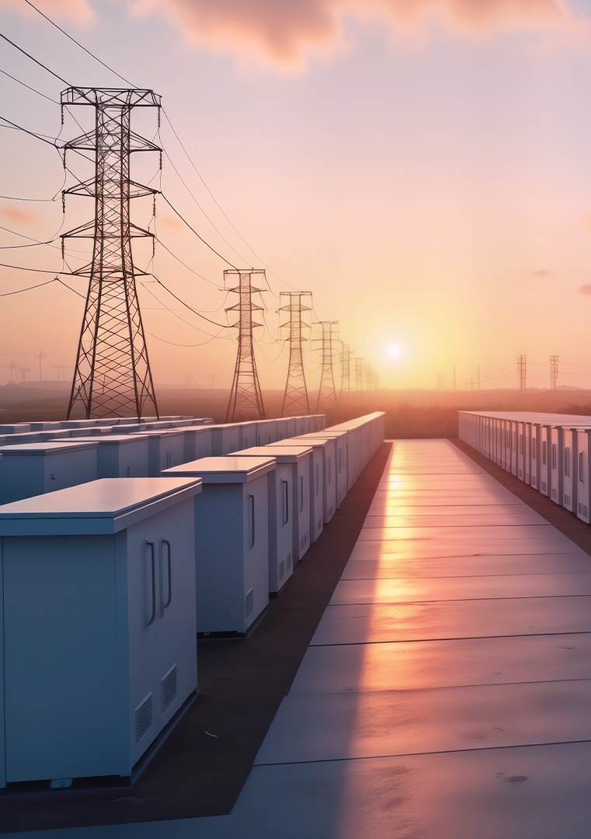
Driving decarbonisation in Australia with a grid-scale storage solution
POWER INFRASTRUCTURE DESIGN & ENGINEERING
THE CHALLENGE
To prepare Australia for net zero and maximise its use of low carbon technologies, major renewables players are seeking innovative, next-level energy storage solutions that harness the power of digitalisation.
THE SOLUTION
As one of the first early grid-scale renewable and energy storage contracts awarded in Australia, nxzen is combined digitalisation with renewable design and build to provide 37.5 Mw of solar and 150 MWH of storage near Perth.
THE OUTCOME
Comprising 10,000 PV modules across a 75 hectare site, it was the largest project of its kind in the country. Through its repeatable model, nxzen is developing three other similar storage sites.

Slide 4


Creating a smart gas network for the future
ASSET INTELLIGENCE & SECURITY
THE CHALLENGE
Ageing infrastructure is causing safety concerns, high run costs and high methane emissions. Cadent wanted to create a gas site fit for the future using asset intelligence monitoring and state of the art digital solutions.
THE SOLUTION
We created and tested four different solutions, using LoRaWAN technology, enabling Cadent to connect to existing equipment without costly telecoms infrastructure:
Acoustic, vibration, and temperature monitoring sensors to alert any potential issues, gas escape and leakage detection sensors, real-time valve monitoring sensors, and near real time pressure monitoring sensors - identifying abnormal pressure patterns/trends.
THE OUTCOME
Our sensors provide Cadent with real time data insights regarding asset performance, leading to operational efficiency and lower safety incidents through data led interventions. This enables a smarter, more efficient operation supporting Cadent’s net zero journey.

Slide 5


Building smart digital societies for the state of Tasmania
ASSET INTELLIGENCE & SECURITY
THE CHALLENGE
To accelerate Tasmania’s transition to a smart, digitalised future, TasNetworks required an innovative partner to improve its asset performance, lower costs and prepare its electricity and telecommunications infrastructure for the future metaverse.
THE SOLUTION
nxzen’s Digital Reality Platform is a cloud-hosted IP solution based on Artificial Intelligence, Machine Learning and LidaR. A digital twin of Tasmania is overlaid with IoT sensing, satellite imagery, drone data, and other reality technologies to create a rich fabric of real-time data and insights. The solution is a partnership between nxzen and TasNetworks’ deregulated business 42-24.
THE OUTCOME
This 10 year operational contract delivers significant improvements for TasNetworks’ efficiency, safety and operations. Data captured has be commercialised to other entities in Tasmania, including state and federal government departments, utilities and industry. The repeatable nature of the solution allows for global market potential.

Slide 6

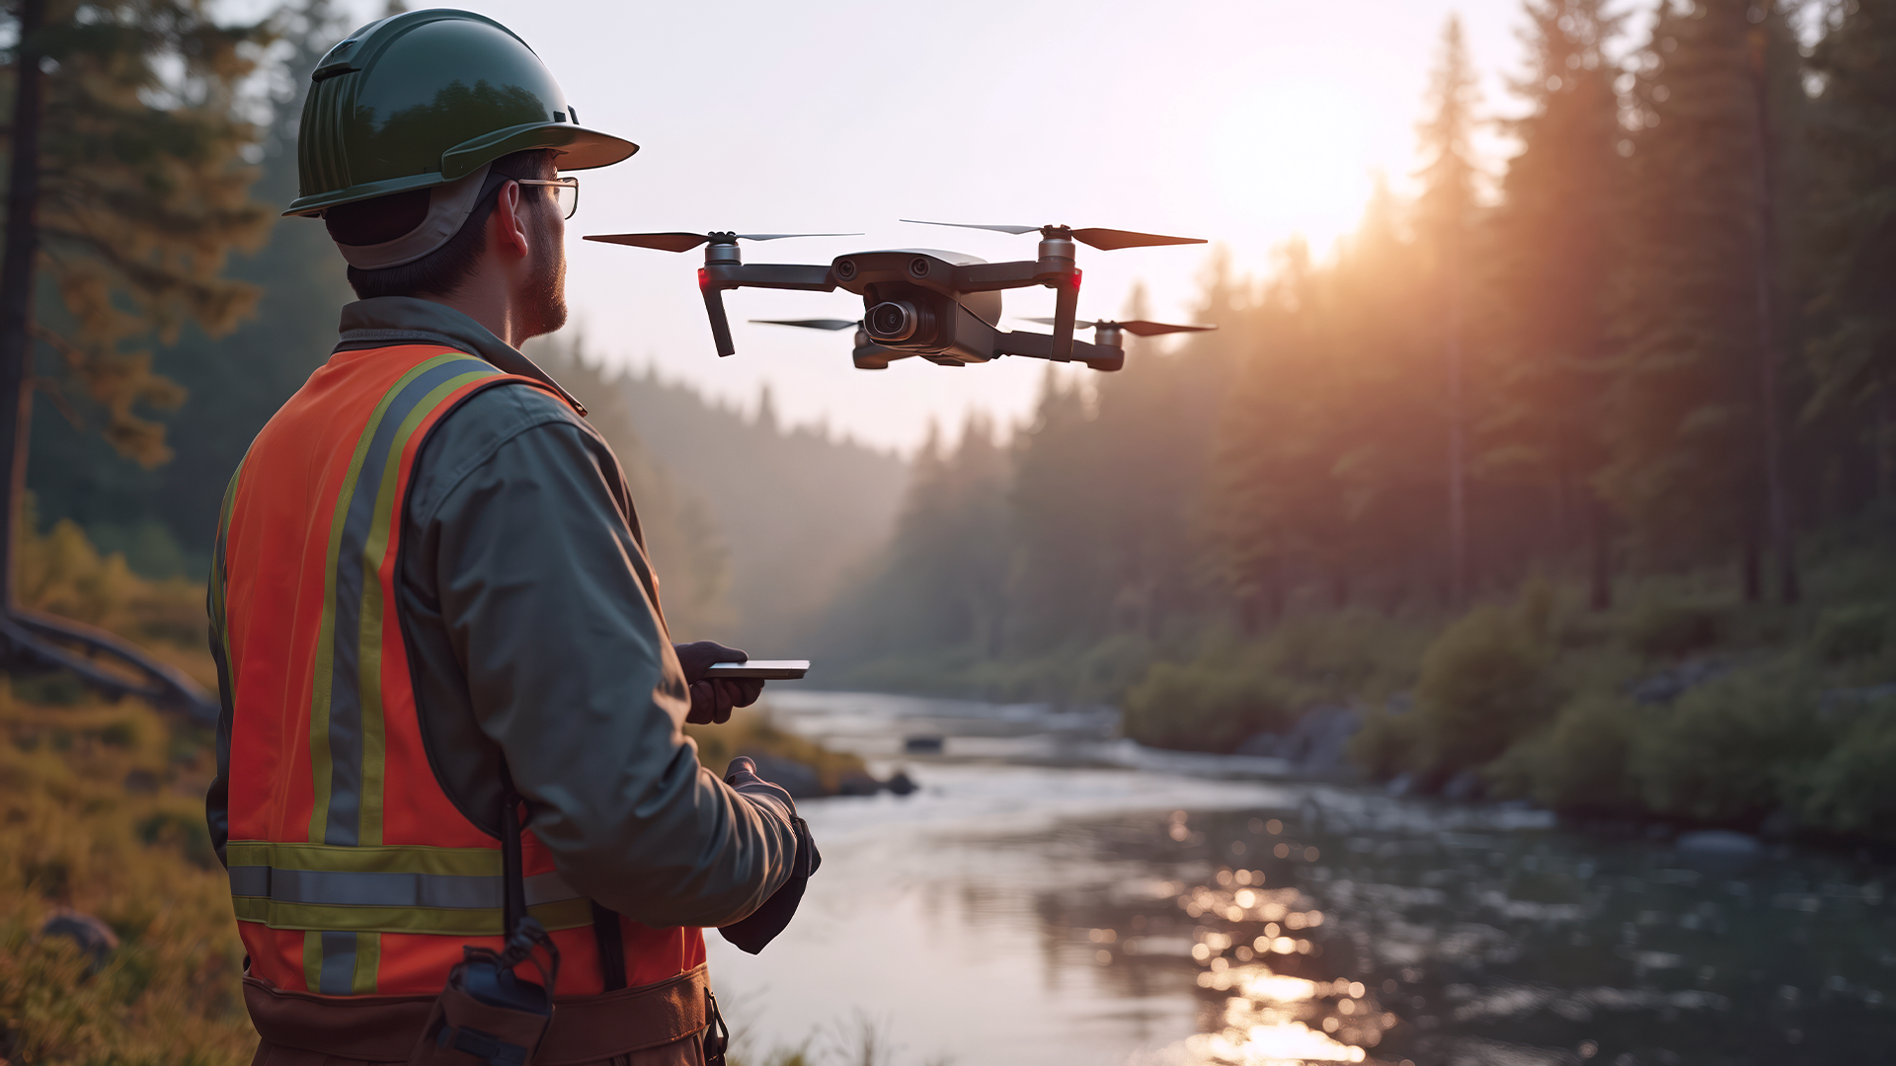
Building smarter, safer water networks with advanced drone technology
ASSET INTELLIGENCE & SECURITY
THE CHALLENGE
United Utilities needed to replace hazardous, inefficient manual inspections with a safer, data-driven approach for thousands of critical assets. Traditional methods were costly, carbon-heavy, and lacked predictive insights for proactive maintenance.
THE SOLUTION
We deployed industrial-grade drones equipped with LiDAR, thermal imaging, and high-resolution cameras to capture detailed asset data in challenging environments. Drone data was encrypted and integrated with existing GIS and asset management systems, enabling predictive maintenance and real-time decision-making through advanced analytics.
THE OUTCOME
This project reduced inspection costs by 30% and cut carbon emissions by 65%, supporting sustainability and Net Zero objectives. We enhanced compliance and resilience under NIS Directive and ISO 27001 audits, improving regulatory performance and operational integrity. Significant financial savings, extended asset life, and an 18-month payback period with long-term ROI was achieved.

Slide 7



Transitioning to a net zero future through network modelling
POWER INFRASTRUCTURE DESIGN & ENGINEERING
THE CHALLENGE
A rapid increase in new connection requests, driven by the rise in electric vehicle infrastructure and demand
THE SOLUTION
An innovative power systems design and engineering solution that offers speed, flexibility, and additional connection capacity
THE OUTCOME
By taking ownership of the connections process we have tripled inflow volumes in 12 months, without a drop in guaranteed standards

Slide 8

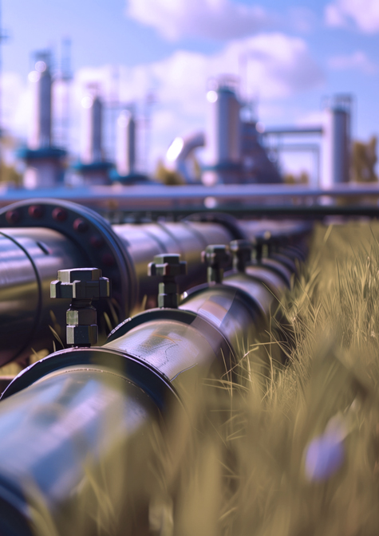
Transforming a UK gas distribution network to a best performer
BUSINESS ADVISORY
THE CHALLENGE
As part of its ambition to become a top-performing UK utility, Wales and West Utilities needed to reduce customer waiting time for quotes and improve its productivity, all at lower cost.
THE SOLUTION
nxzen knowledge practitioners conducted in-depth performance analysis that provided the ability to drill down and execute causal analysis on the utility’s operations.
THE OUTCOME
Through the partnership with nxzen, the customer increase its customer satisfaction score, became the first UK utility to win an ICS Global Excellence Award and won the Customer Services Award six times in a row at the SBGI Gas Industry Awards. Wales & West Utilities also outperformed its targets in Repex, Capex and Opex achieving excellent shareholder returns.

